Slide 1
Iteration 3
Sequence Diagram

Slide 2
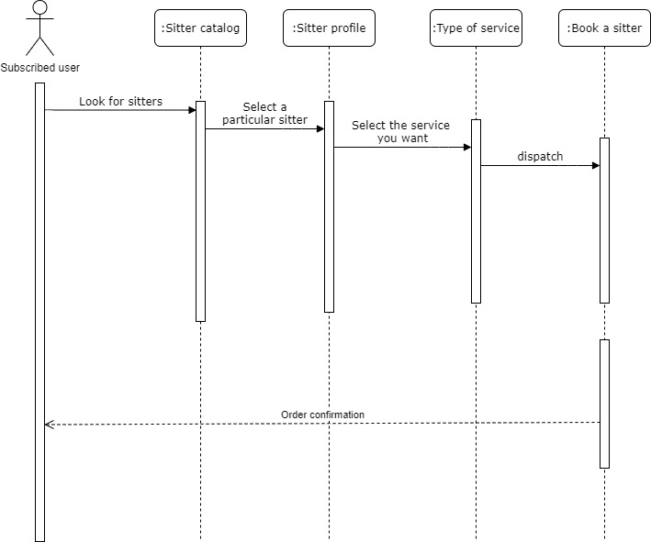
02.02. Selecting a type of service

Slide 3
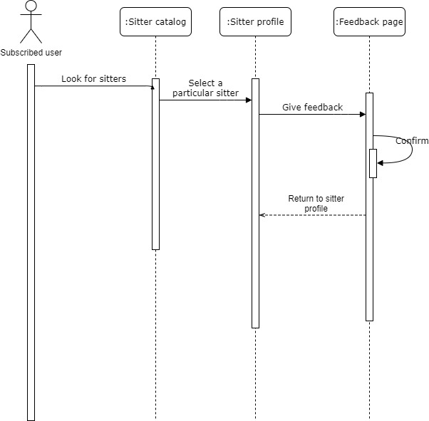
06.01. Feedback

Slide 4
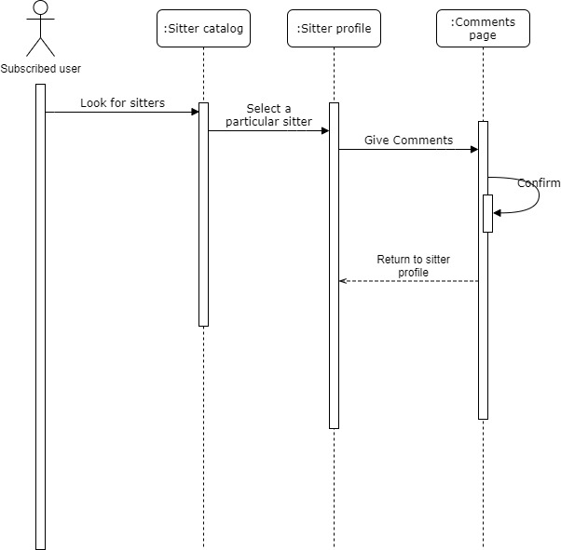
06.02. Comment

Slide 5
Iteration 3
Class Diagram

Slide 6
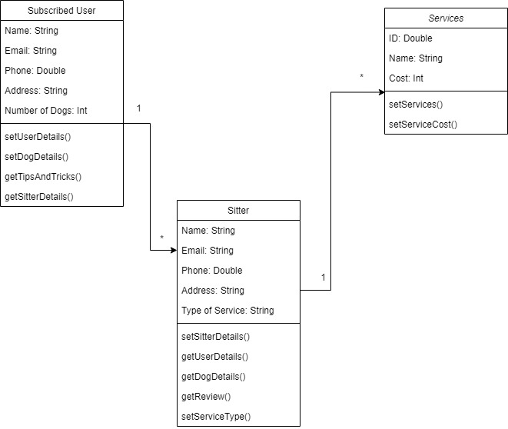
02.02. Selecting a type of service

Slide 7
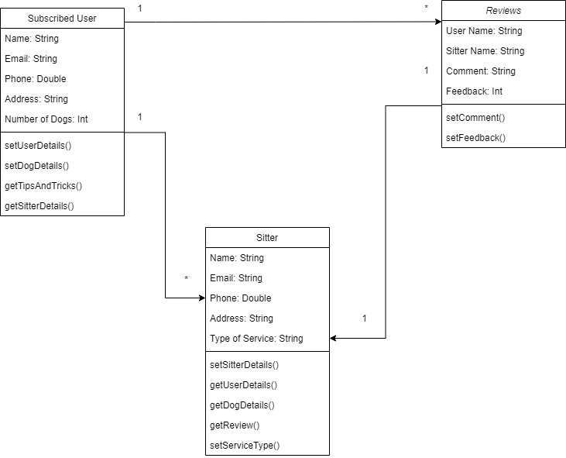
06.01. Feedback

Slide 8
06.02. Comment

Slide 9
Iteration 4
Sequence Diagram

Slide 10
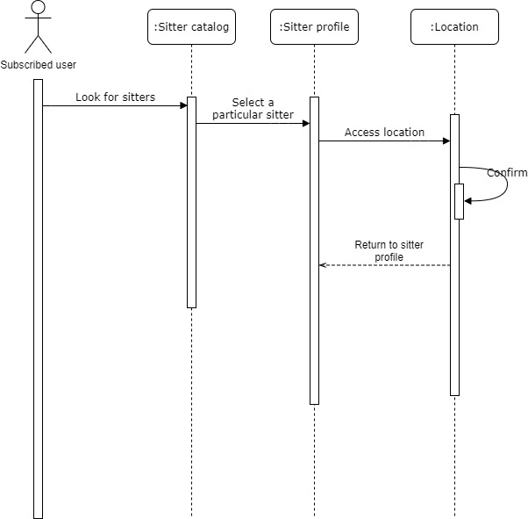
04.01 Accessing Sitter’s location

Slide 11
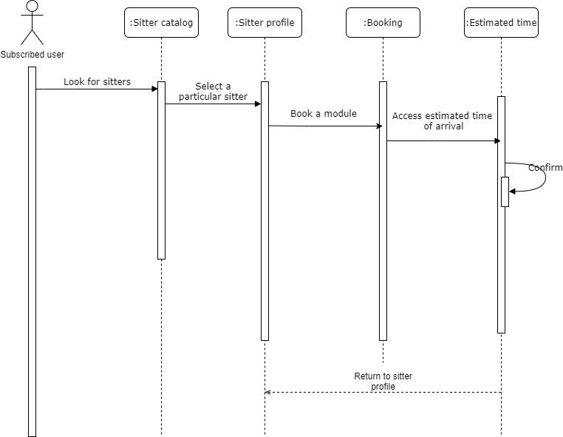
04.02 Estimated Time of Arrival

Slide 12
Iteration 4
Class Diagram

Slide 13
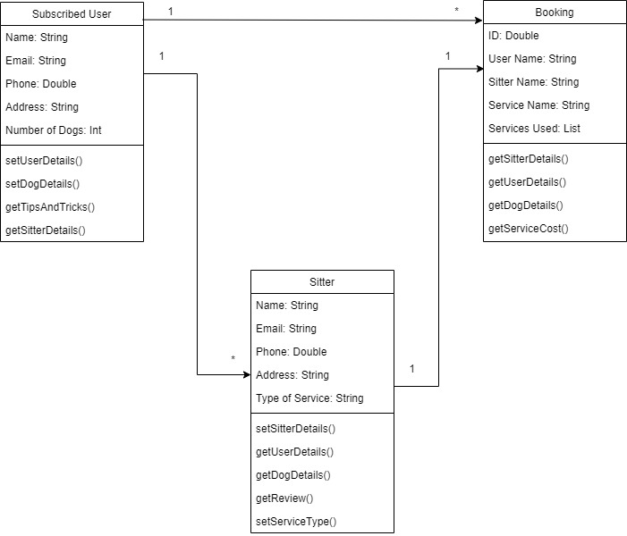
04.01 Accessing Sitter’s location

Slide 14
04.02 Estimated Time of Arrival

